Slide 1
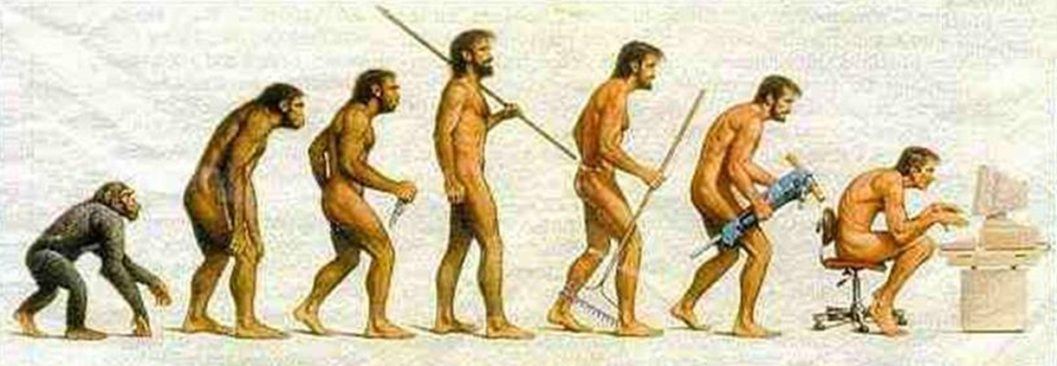
Human evolution

Slide 2
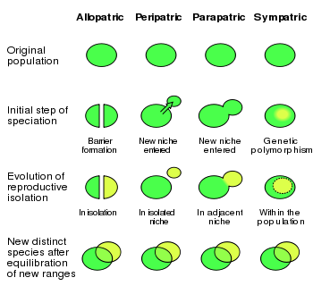
SPECIATION

Slide 3
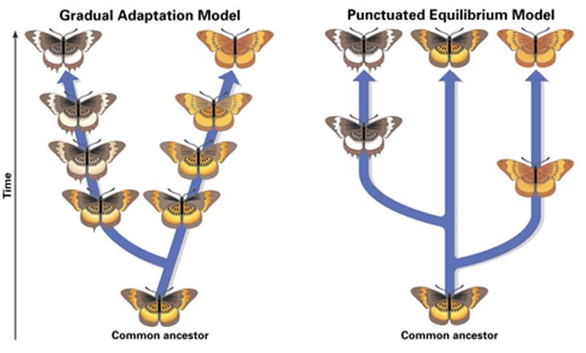

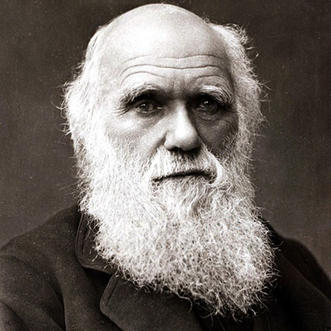

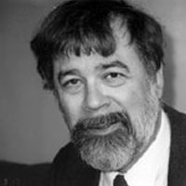
HOW FAST DOES IT HAPPEN?
Stephen Gould
Charles Darwin
Niles Eldredge
Richard Dawkins

Slide 4
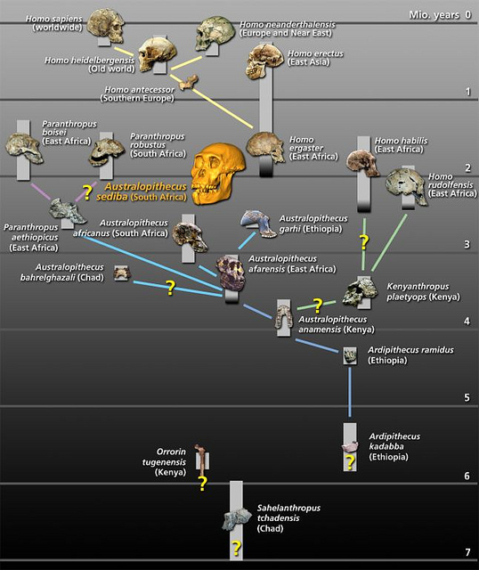
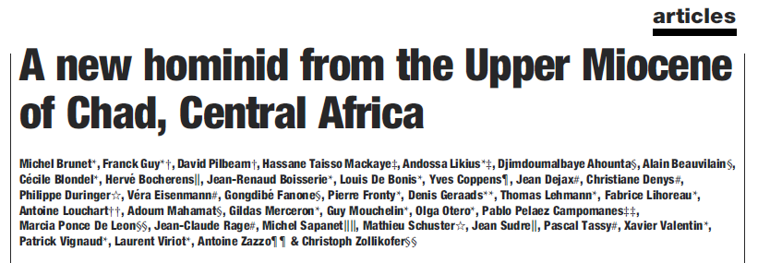
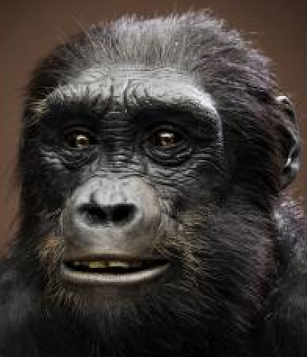
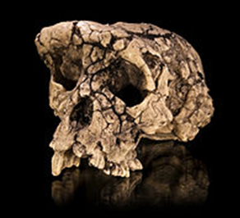
Sahelanthropus tchadensis
Discovered: 2001
Where: Chad (Africa)
We start walking 6mya
IMPORTANT MILESTONES

Slide 5
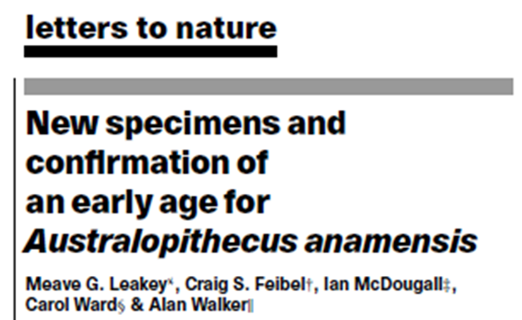
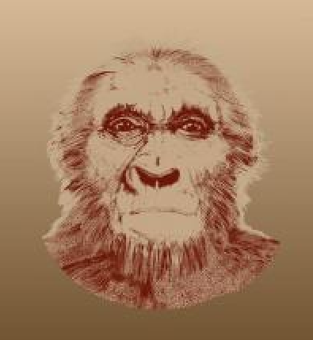
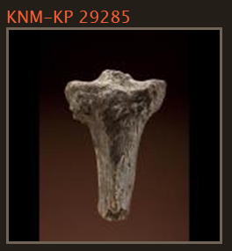
Australopithecus anamensis
Discovered: 1995
Where: Kenia (Africa)
We walked 4.1mya
IMPORTANT MILESTONES

Slide 6
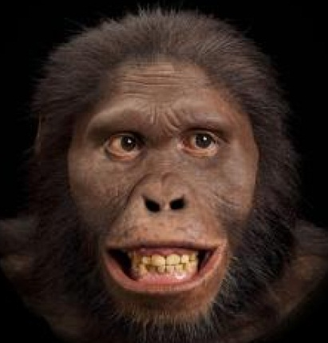
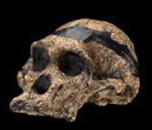
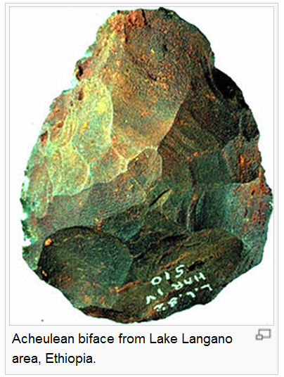
Australopithecus africanus
Discovered: 1924
Where: (Africa)
Dawn of technology 2.6mya
IMPORTANT MILESTONES

Slide 7
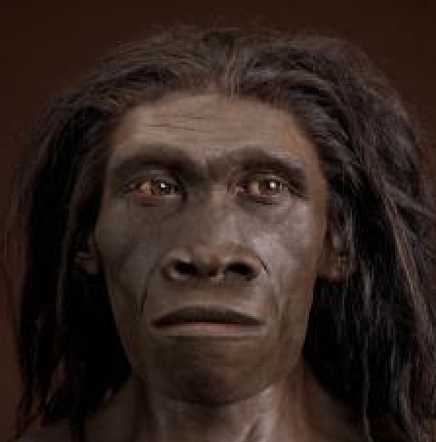
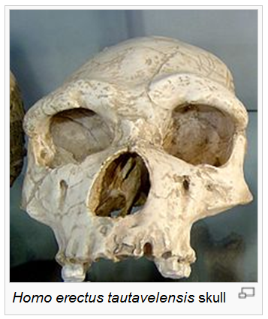
Homo erectus
Discovered: 1891
Where: Indonesia
Control of fire 0.8mya
IMPORTANT MILESTONES

Slide 8
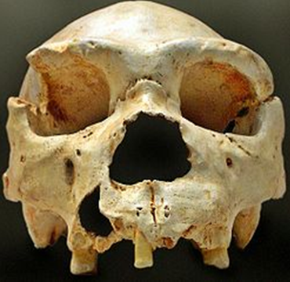
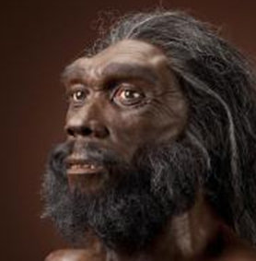
Homo heidelbergensis
Discovered: 1908
Where: Germany
Rapid increase in brain size 0.8mya
IMPORTANT MILESTONES

Slide 9

Domestication of plants and animals
Homo sapiens
Described: 1756
Where: everywhere
IMPORTANT MILESTONES

Slide 10
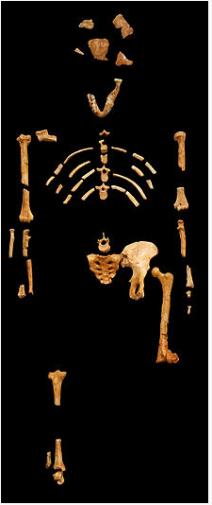
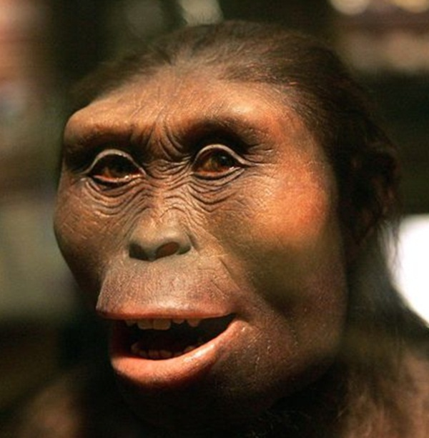
Australopithecus afarensis
Discovered: 1974
Where: Ethiopia
“Lucy, Science 1979”
A new hominid linage
IMPORTANT DISCOVERIES

Slide 11
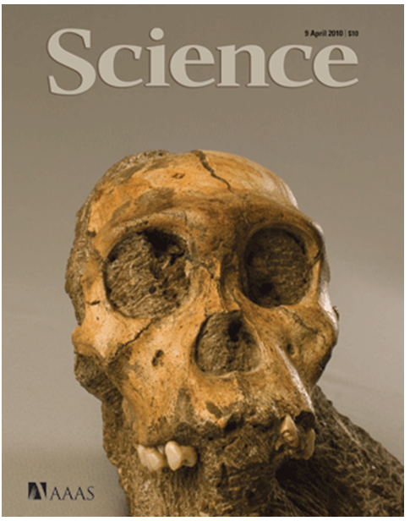
Australopithecus sediba
Discovered: 2010
Where: South Africa
A different ancestor
IMPORTANT DISCOVERIES

Slide 12

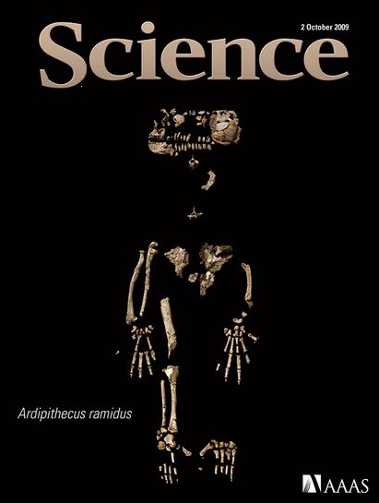
“Ardy”
An earlier origin
IMPORTANT DISCOVERIES

Slide 13
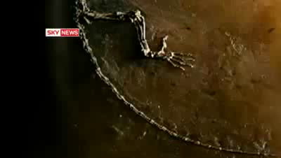
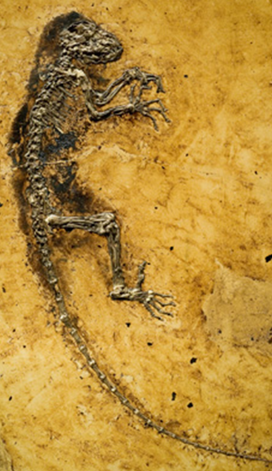
Darwinius masillae, 2009
“Ida”
The missing link, 47 mllion BC
IMPORTANT DISCOVERIES

Slide 14


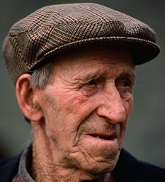
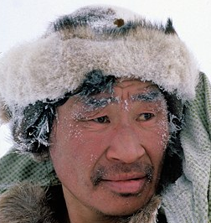


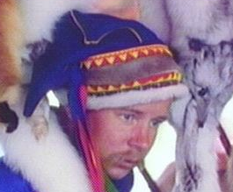
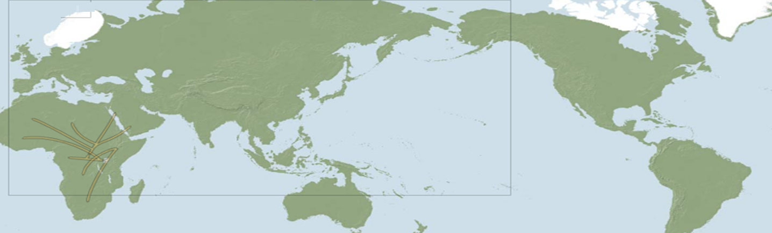
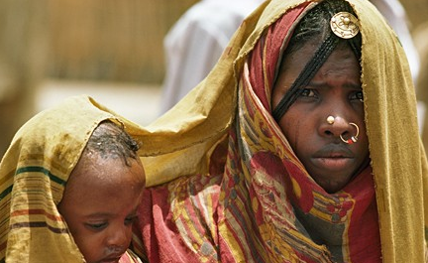


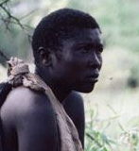


OUR JOURNEY: The Genographic Project
Haplogroup R
Undetermined
Haplogroup A
50,000 BC
Haplogroup M343
35,000 BC
Haplogroup M242
15,000 BC
Haplogroup B
60,000 BC
Haplogroup M3
10,000 BC
Haplogroup M231
Undetermined
Haplogroup L0
100,000 y ago
Haplogroup L3
80,000 y ago
Haplogroup M*
60,000 y ago
Haplogroup M91
55,000 y ago
Haplogroup M174
50,000 y ago
Haplogroup F
Undetermined

Slide 15
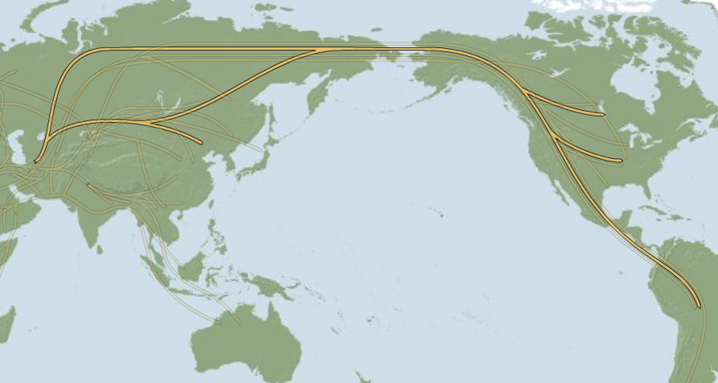
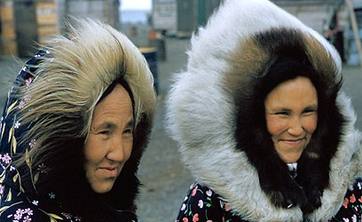

Haplogroup A
50,000 BC

Slide 16
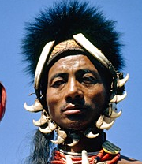
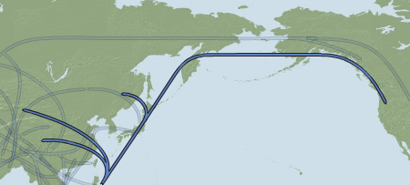
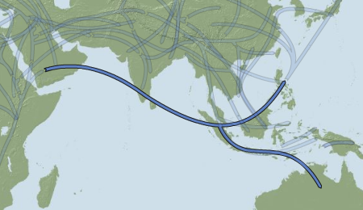
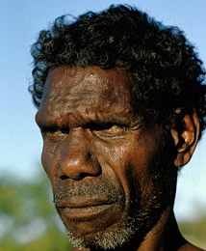
The Genographic Project: Interesting paths
Haplogroup C3
20,000 BC
Haplogroup C
50,000 BC

Slide 17
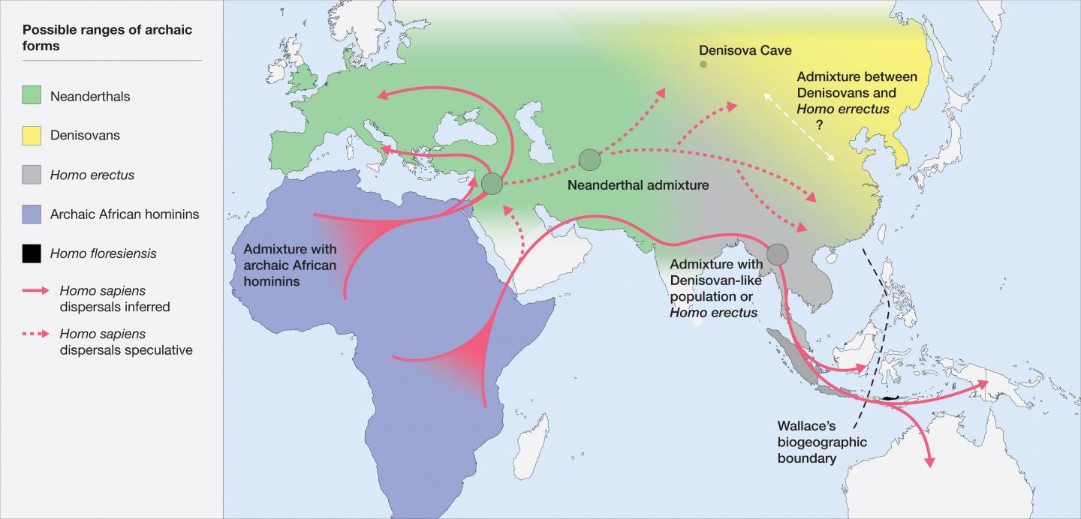
Putting things together
Evolution
Time
Space
BIOGEOGRAPHY
MANY SPECIES
Patterns

